Slide 1





KIET Group of Institutions, Ghaziabad
(An ISO– 9001: 2008 Certified & ‘A+’ Grade accredited
Institution by NAAC)
ML BASED RESUME CLASSIFIER
(Resupro)
PCS-03, Guide: Prof. Abhishek Goyal

Slide 2
Recruiters and hiring managers often face challenges in efficiently screening a large volume of resumes, leading to time-consuming manual processes, human biases, and potential oversight of qualified candidates. Traditional resume screening methods rely heavily on subjective judgment, making it difficult to identify the best-fit applicants for specific job roles consistently.
Moreover, many applicants fail to tailor their resumes according to job descriptions, leading to mismatches between employer expectations and candidate qualifications. This results in inefficiencies in the hiring process, prolonged recruitment cycles, and increased costs for organizations.
PROBLEM STATEMENT

Slide 3
To provide UI/UX to create a candidate’s resume.
To develop a system that automates the initial screening of resumes, reducing the time and resources spent on manual review processes.
The work aims to enhance decision-making during the early stages of recruitment by providing data insights, ultimately improving the selection process and identifying top-tier talent.
OBJECTIVES

Slide 4


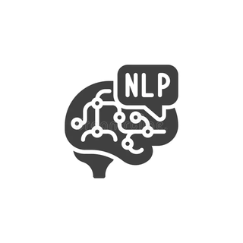

Frontend
Tech Stack
Backend

Slide 5
SDG MAPPING
SDG 4: Quality Education
Goal: Ensure inclusive and equitable quality education and promote lifelong learning opportunities for all.
Justification:
Skill-Based Resume Building – ResuPro helps job seekers create structured and domain-specific resumes, ensuring they effectively highlight their skills and qualifications, thereby improving employability.
Personalized Resume Scoring – The ML-based scoring system helps individuals understand their strengths and areas for improvement, guiding them to enhance their qualifications.
Bridging the Education-to-Employment Gap – By categorizing resumes based on skills, experience, and job roles, ResuPro supports fresh graduates and professionals in transitioning into the workforce efficiently.
SDG 17: Partnerships for the Goals
Goal: Strengthen the means of implementation and revitalize the global partnership for sustainable development.
Justification:
Collaboration with Educational Institutions – ResuPro can be integrated with universities, career counseling services, and online learning platforms to assist students in building industry-ready resumes.
Engagement with Recruiters and HR Professionals – Companies can use the platform to streamline candidate screening, enhancing hiring efficiency and diversity.
AI-Powered Job Market Insights – By analyzing large-scale resume data, ResuPro provides trends and insights into job market demands, benefiting stakeholders in education and employment.

Slide 6
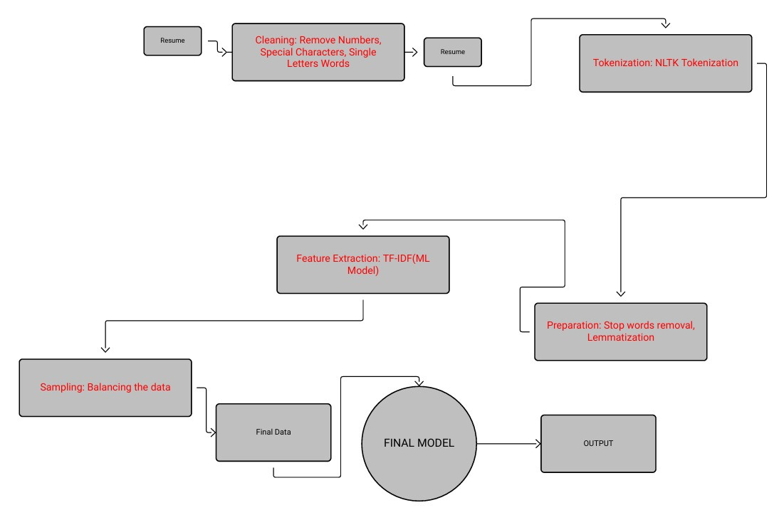
WORKFLOW

Slide 7
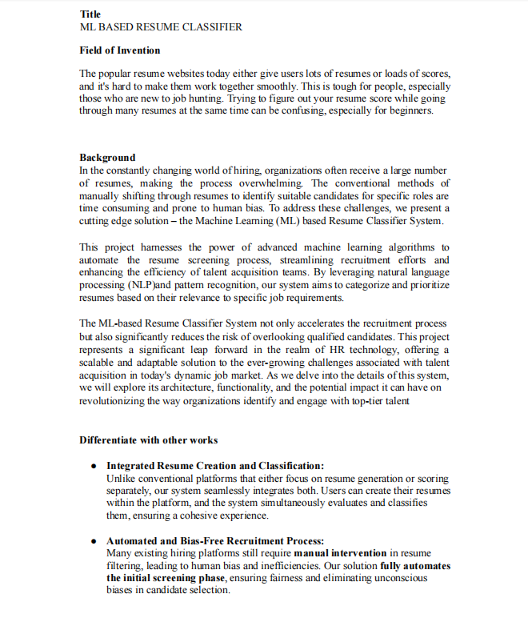
PATENT
Status: Submitted

Slide 8
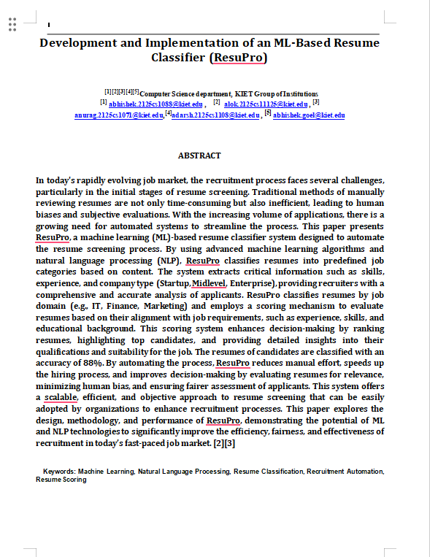
RESEARCH PAPER
Status: Submitted

Slide 9
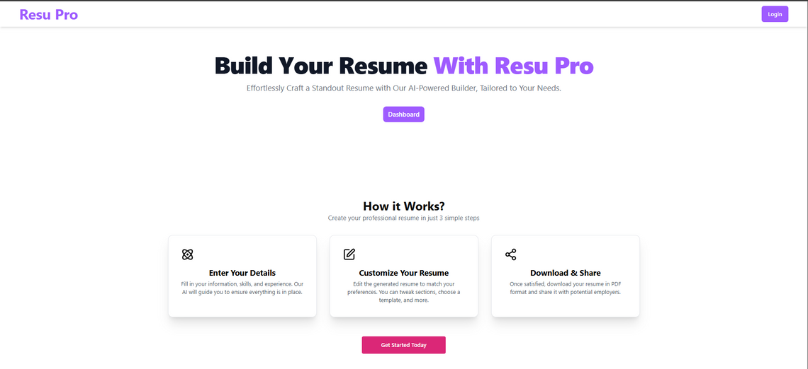
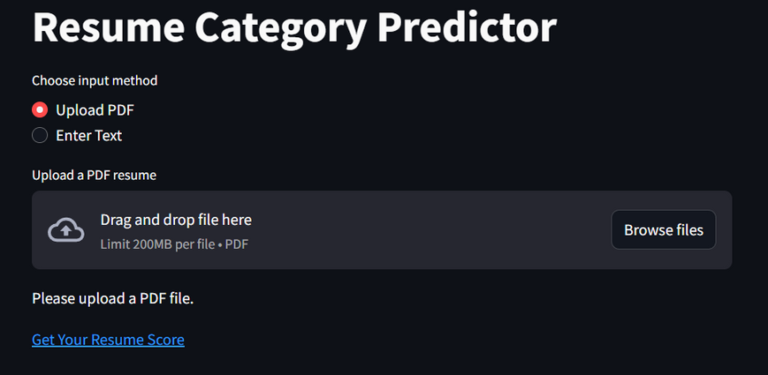
PROJECT
Team Members
Abhishek Verma
Adarsh Mishra
Alok Ranjan Dubey
Anurag Kumar
Status: 90%

Slide 10

Thank you
for attending!

